Slide 1
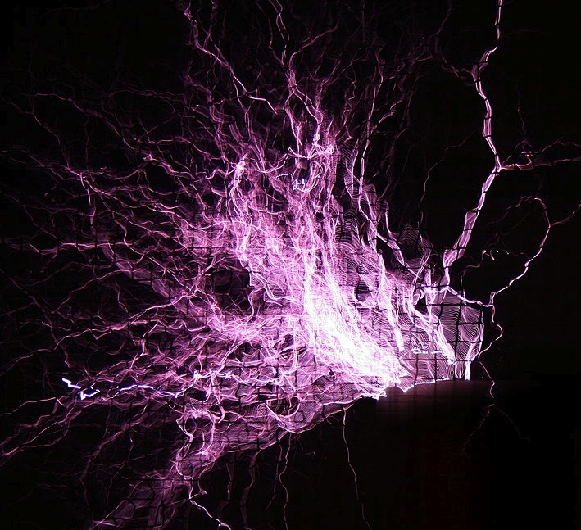
CASA0007: Quantitative Methods
Dr Thomas OLÉRON EVANS
thomas.evans.11@ucl.ac.uk
Dr Hannah FRY
hannah.fry@ucl.ac.uk
Moodle password: QM2018
Centre for Advanced
Spatial Analysis,
90 Tottenham Court Road
https://commons.wikimedia.org/wiki/File:Tesla_coil_Vienna_Technical_Museum_2007_a.jpg

Slide 2

OBJECTIVES 1. Understand the concept of data standardisation and recognise different approaches. 2. Understand the purpose of cluster analysis and know the algorithms for k-means and hierarchical clustering. 4. Understand how SSE and silhouette scores can be used to assess the quality of a clustering.
https://commons.wikimedia.org/wiki/File:Tesla_coil_Vienna_Technical_Museum_2007_c.jpg

Slide 3
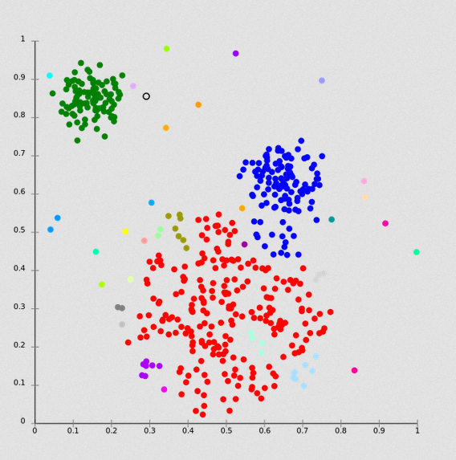
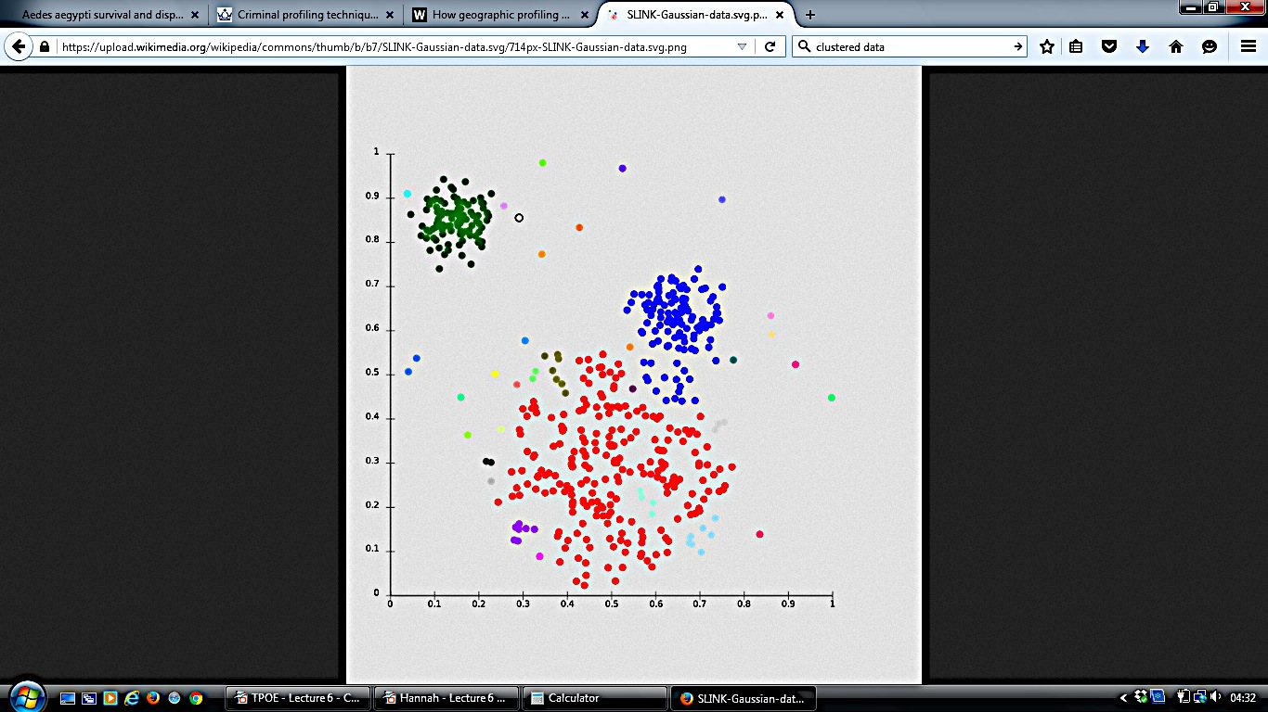




Clustering – Concept
https://commons.wikimedia.org/wiki/File:SLINK-Gaussian-data.svg
Notes:
Here’s some clumpy data.
Are they all the same thing?

Slide 4
Clustering – Concept
https://commons.wikimedia.org/wiki/File:SLINK-Gaussian-data.svg

Slide 5
Standardisation
Comparing Variables with Different Units

Slide 6

http://www.imdb.com/title/tt2126355/

Slide 7
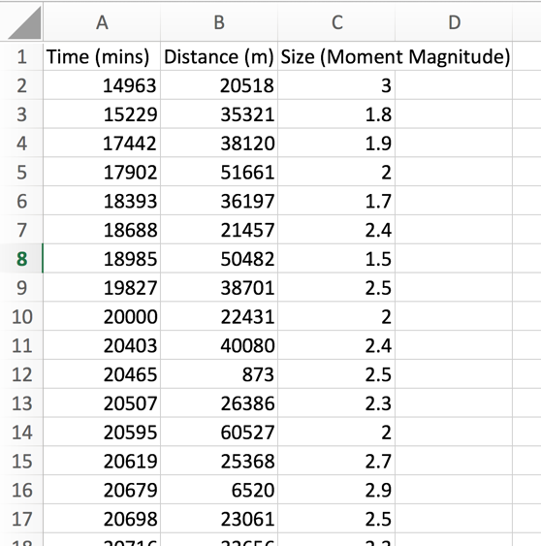
tremor_data.csv

Slide 8
Distance along fault line (km)
Time (Hours after start of study)

Slide 9
Distance along fault line (m)
Time (Hours after start of study)

Slide 10
Distance along fault line (m)
Time (Minutes after start of study)

Slide 11
http://www.imdb.com/title/tt2126355/

Slide 12
Standardisation
Comparing Variables with Different Units
(or with different means / standard deviations)

Slide 13
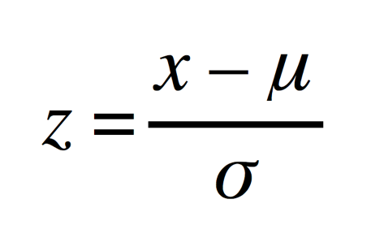
Standardisation
For roughly normally distributed data
(i.e. not highly skewed)
Data
Mean
Standardised
Data
Standard
Deviation

Slide 14
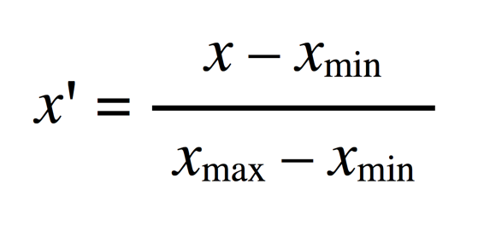
Min-Max Rescaling
For highly non-normal data (i.e. highly skewed)
Original Data
Rescaled
Data
(Could also consider log transformation for power law like data)
Notes:
Already seen that the mean is not a good measure for skewed data (think of geometric mean stuff in week one & all the power law stuff in weeks 2/3)
What would the max value be? And the min?
Think of this as a proportion of how far along the scale you are.
Maps use this a lot.

Slide 15
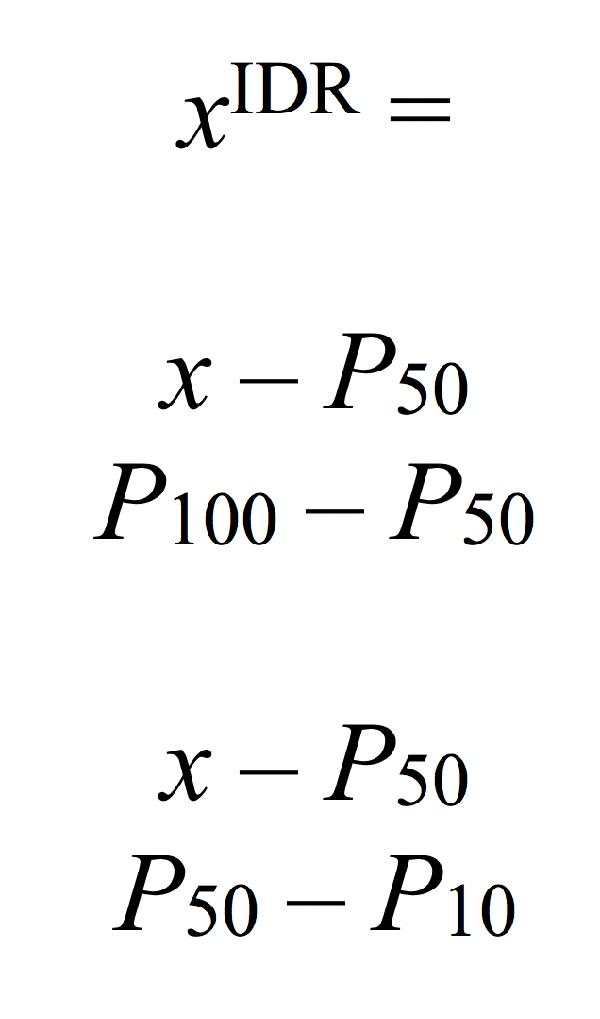
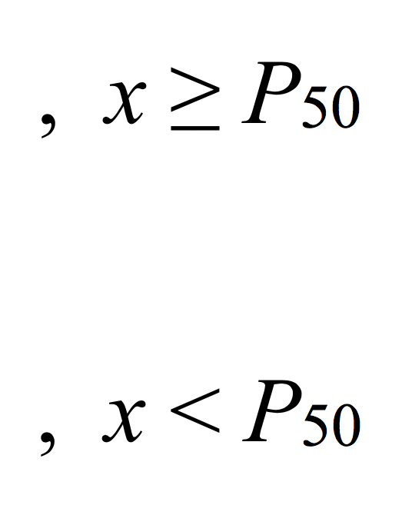
IDR Standardisation
Non-normal data with significant outliers
Original
Data
Rescaled
Data
( See e.g. https://www.ons.gov.uk/methodology/geography/geographicalproducts/areaclassifications/2011areaclassifications/methodologyandvariables )
Notes:
Already seen that the mean is not a good measure for skewed data (think of geometric mean stuff in week one & all the power law stuff in weeks 2/3)
What would the max value be? And the min?
Think of this as a proportion of how far along the scale you are.
Maps use this a lot.

Slide 16
Explicit Rescaling
y : Distance along fault line (m)
Y = y / 10000
x : Time (Minutes after start of study)
X = 2 x / 10000

Slide 17
Shopping Example
North Pole Frozen Foods
LOYALTY
CARD
0985 6788 7345 8895 9222
DR. S. CLAUS
Notes:
Target?

Slide 18
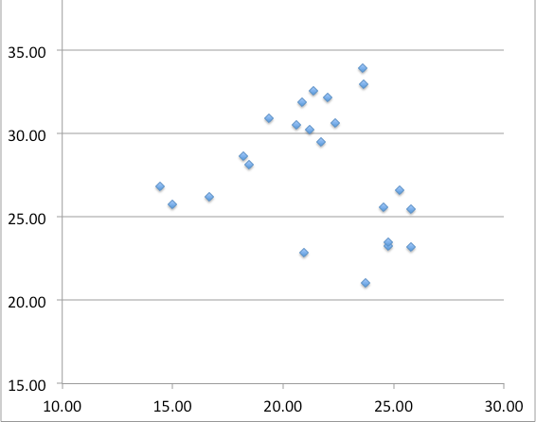
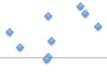
K-means Clustering
Mean spend in Shop B
(£)
Mean spend in Shop A (£)
Notes:
Let’s do an example along those lines.

Slide 19
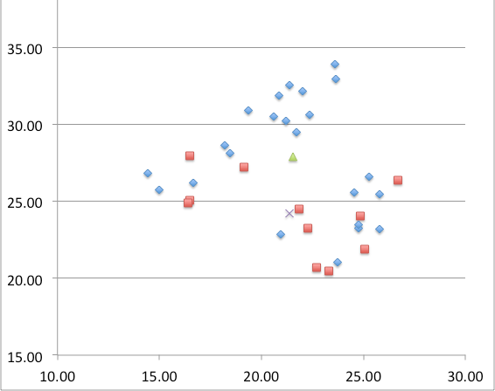
K-means Clustering
Mean spend in Shop B
(£)
Mean spend in Shop A (£)

Slide 20
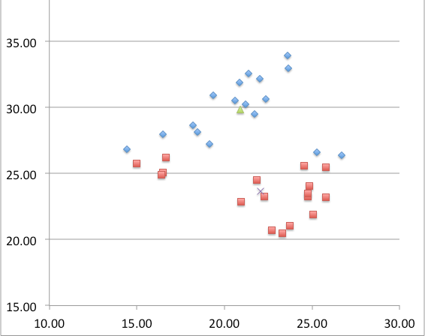
K-means Clustering
Mean spend in Shop B
(£)
Mean spend in Shop A (£)

Slide 21

K-means Clustering
Mean spend in Shop B
(£)
Mean spend in Shop A (£)

Slide 22
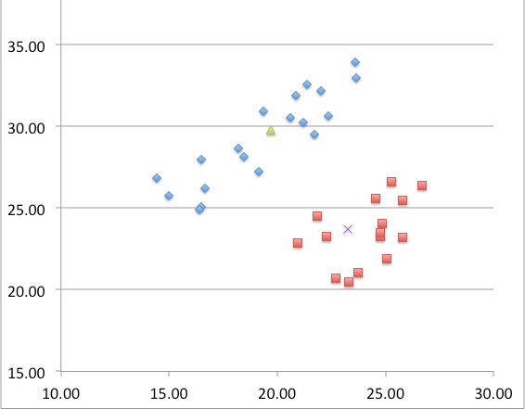
K-means Clustering
Mean spend in Shop B
(£)
Mean spend in Shop A (£)

Slide 23
k-Means Disadvantages
1. Requires knowledge of the number of clusters;
2. Sensitive to initialisation, which can lead to poor solutions;
3. Sensitive to outliers, which can results in inaccurate clusters;
4. Incapable of handling clusters of a non-convex shape;
5. Inapplicable to categorical data.

Slide 24
Hierarchical Clustering
r = 0
Clusters (6)
A
B
C
D
E
F
A
B
D
F
C
E

Slide 25
Hierarchical Clustering
r = 0.9
Clusters (6)
A
B
C
D
E
F
A
B
D
F
C
E

Slide 26
Hierarchical Clustering
r = 2
Clusters (4)
A
B C
D E
F
A
B
D
F
C
E

Slide 27
Hierarchical Clustering
r = 2.7
Clusters (4)
A
B C
D E
F
A
B
D
F
C
E

Slide 28
Hierarchical Clustering
r = 4.2
Clusters (3)
A
B C
D E F
A
B
D
F
C
E

Slide 29
Hierarchical Clustering
r = 6
Clusters (2)
A
B C D E F
A
B
D
F
C
E

Slide 30
Hierarchical Clustering
r = 10.2
Clusters (1)
A B C D E F
A
B
D
F
C
E

Slide 31
Hierarchical clustering
Agglomerative Bottom Up: Begins with one cluster per data point; Gradually merges into larger clusters.
Divisive Top Down: Begins with one big cluster; Gradually splits into smaller clusters.
Requires… A dissimilarity measure (a distance)

Slide 32
Hierarchical Clustering
Dendrogram
A
F
E
D
C
B
D
B
F
C
E
A
r

Slide 33
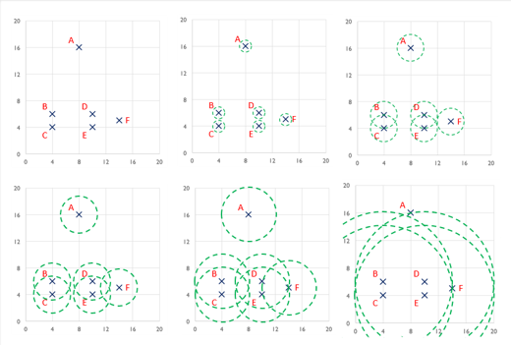
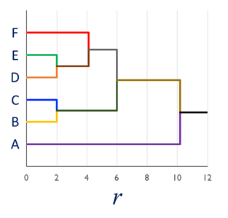
Hierarchical Clustering
Dendrogram

Slide 34
Hierarchical Clustering
Dendrogram

Slide 35
Hierarchical Clustering
Dendrogram
N
F
E
D
C
B
A
r
r

Slide 36
Clustering
Definition: Type of analysis that divides observations into on groups based on some similarity criteria (distance).
Examples: K-Means, Hierarchical clustering

Slide 37
Clustering
Definition: Type of analysis that divides observations into on groups based on some similarity criteria (distance).
Examples: K-Means, Hierarchical clustering
How do we know our groups make sense?

Slide 38
Measuring Clustering Quality
Necessary when…
Comparing different random implementations of k-means
Comparing clusterings with different numbers of clusters
Comparing different clustering techniques (e.g. k-means vs hierarchical)

Slide 39
Method I : SSE / Elbow Method

Slide 40
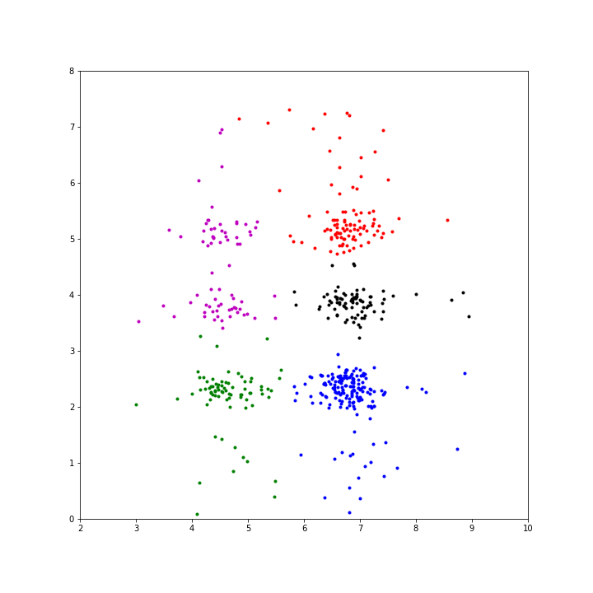
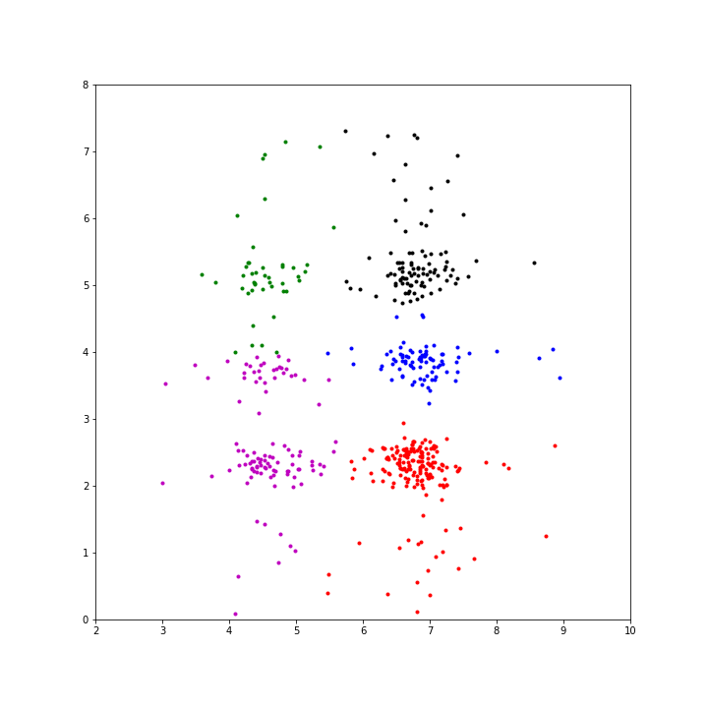
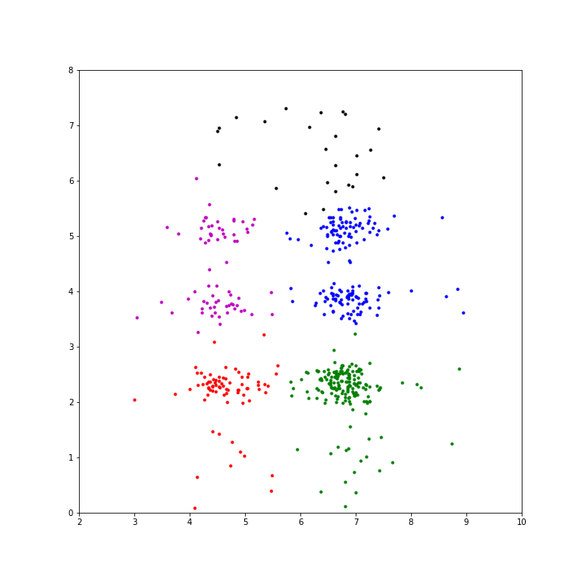
Measuring Clustering Quality
Method 1 – SSE
Comparing Different Random k-Means Clusterings
k = 5
SSE = 262.4
k = 5
SSE = 275.6
k = 5
SSE = 289.9
Notes:
Draw diagram on board to explain.

Slide 41
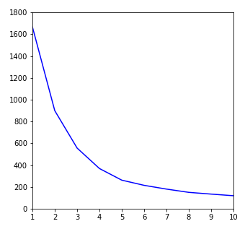
Measuring Clustering Quality
Method 1 – Elbow Diagram
Choosing the number of clusters
Y
SSE
X
k (Number of Clusters)

Slide 42

Method II : Silhouette Analysis
Choosing the right number of clusters
IMAGE: nattu - https://commons.wikimedia.org/wiki/File:Creative_independence.jpg

Slide 43
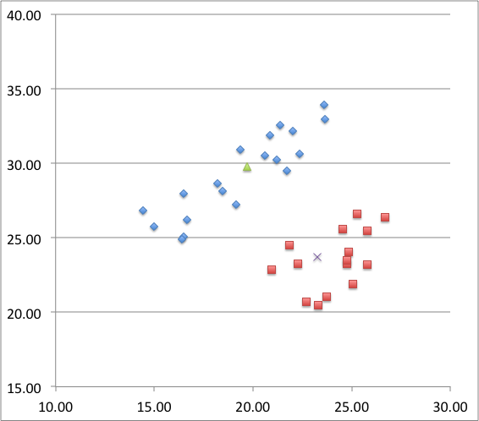
How well clustered is this data?
Mean spend in Shop B
(£)
Mean
spend in Shop A
(£)

Slide 44
How well clustered is this data?
Mean spend in Shop B
(£)
Point 1
Mean
spend in Shop A
(£)

Slide 45
How well clustered is this data?
Mean spend in Shop B
(£)
a(1)
Mean
spend in Shop A
(£)

Slide 46
How well clustered is this data?
Mean spend in Shop B
(£)
b(1)
Mean
spend in Shop A
(£)

Slide 47
How well clustered is this data?
b(1) – a(1)
Mean spend in Shop B
(£)
b(1)
a(1)
Mean
spend in Shop A
(£)

Slide 48
The Silhouette of a Point
poorly
clustered
well
clustered
Silhouette Score
for a Clustering
=
Average of s(i)
for all points i

Slide 49
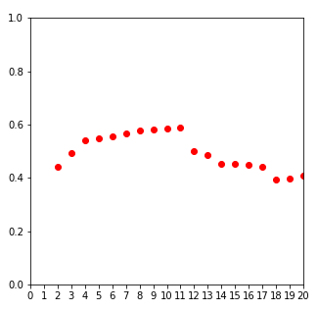
Measuring Clustering Quality
Method 1I – Compare Silhouette Scores (k-means)
Silhouette Score
Y
X
k (Number of Clusters)

Slide 50
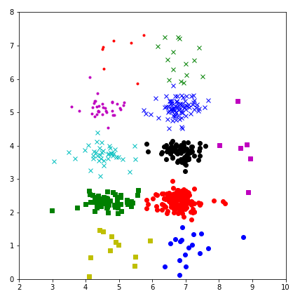
Measuring Clustering Quality
Method 1I – Compare Silhouette Scores (k-means)
Y
‘Optimal’ k-Means
k = 11
S. Score = 0.59
X

Slide 51
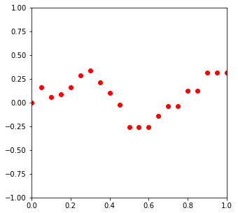
Measuring Clustering Quality
Method 1I – Compare Silhouette Scores (Hierarchical)
Silhouette Score
Y
X
r (agglomeration threshold)

Slide 52
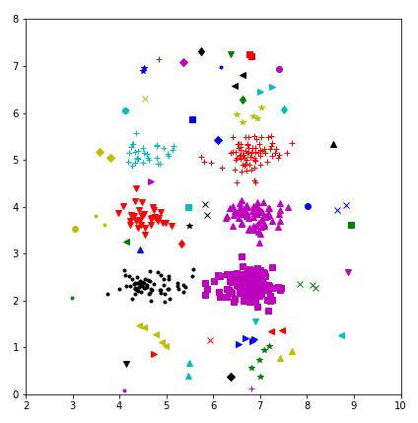
Measuring Clustering Quality
Method 1I – Compare Silhouette Scores (Hierarchical)
Y
‘Optimal’ Hierarchical Agglomerative Clustering
r = 0.3
k = 55
S. Score = 0.34
X

Slide 53
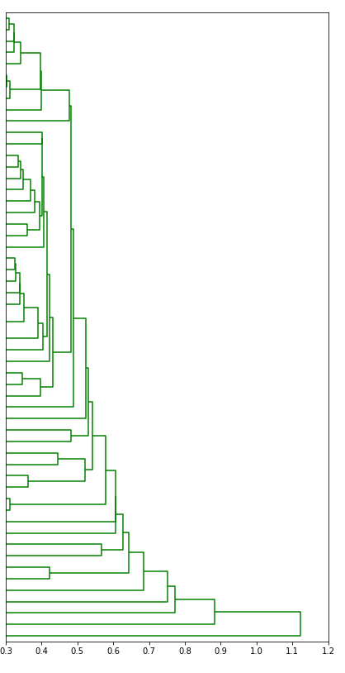
Measuring Clustering Quality
Method 1I – Compare Silhouette Scores (Hierarchical)
Y
X
r (agglomeration threshold)

Slide 54
Clustering : What Next?
Identify clusters
Observe and interpret
Consider analysing separately

